Slide 1
Hate Speech Detection From Social Media
SHREYANSH NETAM (IIT2020177)

Slide 2
INTRODUCTION
This mini project involves the development of a Python script for detecting hate speech in tweets. The script uses sentiment analysis techniques to classify tweets as either containing hate speech, offensive language, or non-hate/non-offensive speech.
The project demonstrates the effective use of natural language processing techniques and classification algorithms in detecting hate speech in social media.

Slide 3
LITERATURE REVIEW
Hate speech detection has been studied using various approaches
Supervised learning is effective but requires expensive labeling of data
Unsupervised learning doesn't require labeling but may not be as accurate
Lexical analysis is simple but may not detect new forms of hate speech
Semantic analysis is more accurate but requires significant computational resources
Deep learning models show promising results but require a large amount of labeled data and are computationally expensive.

Slide 4
METHODOLOGY
Importing necessary libraries:
The program imports several libraries such as numpy, pandas, matplotlib, nltk, sklearn, seaborn, and wordcloud. These libraries are used for data manipulation, analysis, visualization, and machine learning.
Downloading datasets from nltk:
The program downloads two datasets from the Natural Language Toolkit (nltk) library. The first dataset is 'wordnet' which contains English words and their definitions. The second dataset is 'stopwords' which contains a list of common words that are usually removed from text data.
Loading dataset:
The program loads a dataset named 'HateSpeechData.csv' using pandas' read_csv() function. This dataset contains two columns: 'class' and 'tweet'. The 'class' column represents the label of each tweet, and the 'tweet' column represents the tweet's text.

Slide 5
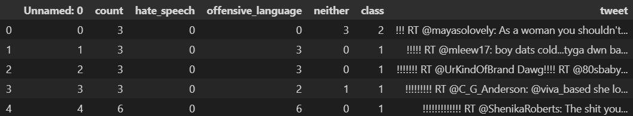
Data preprocessing:
The program preprocesses the tweet text using several techniques such as lemmatization, URL removal, user mention removal, special character removal, and more. The preprocessing function returns the processed text in a list.
Feature extraction:
The program extracts features from the preprocessed text using the CountVectorizer method from sklearn. The maximum number of features is set to 2000, which means only the top 2000 most frequent words in the text are used as features.

Slide 6
Splitting dataset into training and testing set:
The program splits the dataset into training and testing sets using the train_test_split() method from sklearn. The testing set size is set to 20%.
Training various machine learning models:
The program trains several machine learning models such as Gaussian Naive Bayes, Decision Tree, K-Nearest Neighbors, Logistic Regression, and Random Forest on the training set.
Predicting the label of testing set:
The program predicts the label of the testing set using each of the trained models.
Evaluating the performance of each model:
The program evaluates the performance of each model by calculating the confusion matrix and accuracy score. The confusion matrix is a table that shows the number of true positives, true negatives, false positives, and false negatives. The accuracy score is the percentage of correct predictions.

Slide 7
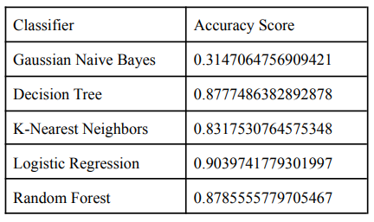
RESULT
So, logistic Regression looks better to predict hate speech based on this dataset.

Slide 8
DataSet and tools used
DataSet
Dataset using Twitter data, is was used to research hate-speech detection. The text is classified as: hate-speech, offensive language, and neither.
TOOLS
Python 3.10.8
nltk
numpy
pandas
matplotlib
scikit-learn
seaborn
Wordcloud
Github Link: https://github.com/SHRYNSHNETAM/HateSpeechDetection_Project

Slide 9
Conclusion
In conclusion, the hate speech detection code presented in this mini project shows promising results for detecting hate speech and offensive language in tweets. The preprocessing techniques used in the code help to remove noise and standardize the text data, while the classifiers trained on the preprocessed data achieve high accuracy scores on the testing set. The Logistic Regression classifier, in particular, performs well on the test tweets, indicating its potential usefulness in detecting hate speech and offensive language in real-time.

Slide 10
REFERENCES
Challenges of Hate Speech Detection in Social Media
https://link.springer.com/article/10.1007/s42979-021-00457-3
Detecting Hate Speech in Social Media
https://arxiv.org/abs/1712.06427
Hate Speech Detection in social media
https://ieeexplore.ieee.org/document/9573687
Hate Speech Detection Using Machine Learning
https://vitalflux.com/hate-speech-detection-using-machine-learning/

Slide 11
THANK YOU

